Slide 1
lucidum
An R Shiny app to build and understand GLMs and GBMs
Gary Hemming
March 2022

Slide 2
lucidum example use cases
I use lucidum to
Explore new client datasets for the first time
Perform interactive actual vs expected charting
Plot KPIs on a map of the UK at postcode area, sector and unit level
Build and tabulate GLMs
Understand GBM features & interactions using SHAP values
Build GBMs to support a GLM build
As a training tool to better understand how GBMs work

Slide 3









What we will cover
1. Loading datasets into lucidum
2. Specification files make lucidum more useful
3. lucidum controls and app layout
4. Using SHAP values for interaction detection
Appendices
Installation
Tips

Slide 4
1. Loading datasets into lucidum
Example: 01_lucidum_load_football.R
Load your dataset into the R Global Environment using fread, readr etc – whatever you prefer.
To load your dataset into lucidum, first load the lucidum package using the library function and then use the lucidum function to load your dataset:
library(lucidum)
lucidum(my_dt)
If you create any new dataset columns, lucidum’s behaviour depends on whether you supplied a data.frame or a data.table:
data.frame – the changes are lost when you quit lucidum
data.table – the changes are retained when you quit lucidum – useful if you want to do something with them
If you plan on building a model, convert character columns to factors before loading into lucidum – this also speeds up summary operations.
# function to convert data.table character columns to factor
char_to_factor <- function(d){
changeCols <- names(d)[sapply(d, is.character)]
d[,(changeCols):= lapply(.SD, as.factor), .SDcols = changeCols]
}
char_to_factor(my_dt)
Don’t call your dataset “d” as that is the name lucidum uses internally for the dataset.
Don’t include any unusual column types, e.g. shapefiles or images – lucidum will probably go wrong!

Slide 5
2. Specification files make lucidum more useful
Example: 02_lucidum_load_football_specs.R
Specification files are .csv files that tell lucidum:
KPI specification: the KPIs you are interested in and how you want to format them for display
Filter specification: filters that you are interested in applying to the
Feature specification: convenient grouping for features and feature scenarios that you want to consider in your models
You don’t need to use specification files, but they make life easier if you are going to be reviewing a dataset on a regular basis.
Create specification files using lucidum itself or in a text editor or Excel.
Save the specification files in folders called: “feature specifications”, “kpi specifications” and “filter specifications” - SCREENSHOT
Set the path to the specification files before running library(lucidum) or it won’t pick up the path:
options(lucidum=list(specification_path=“my_path”))
library(lucidum)
lucidum(my_dt)
If you want to change the path without restarting R, you need to detach lucidum and reload the library:
detach("package:lucidum", unload = TRUE)
options(lucidum=list(specification_path=“my_different_path”))
library(lucidum)

Slide 6
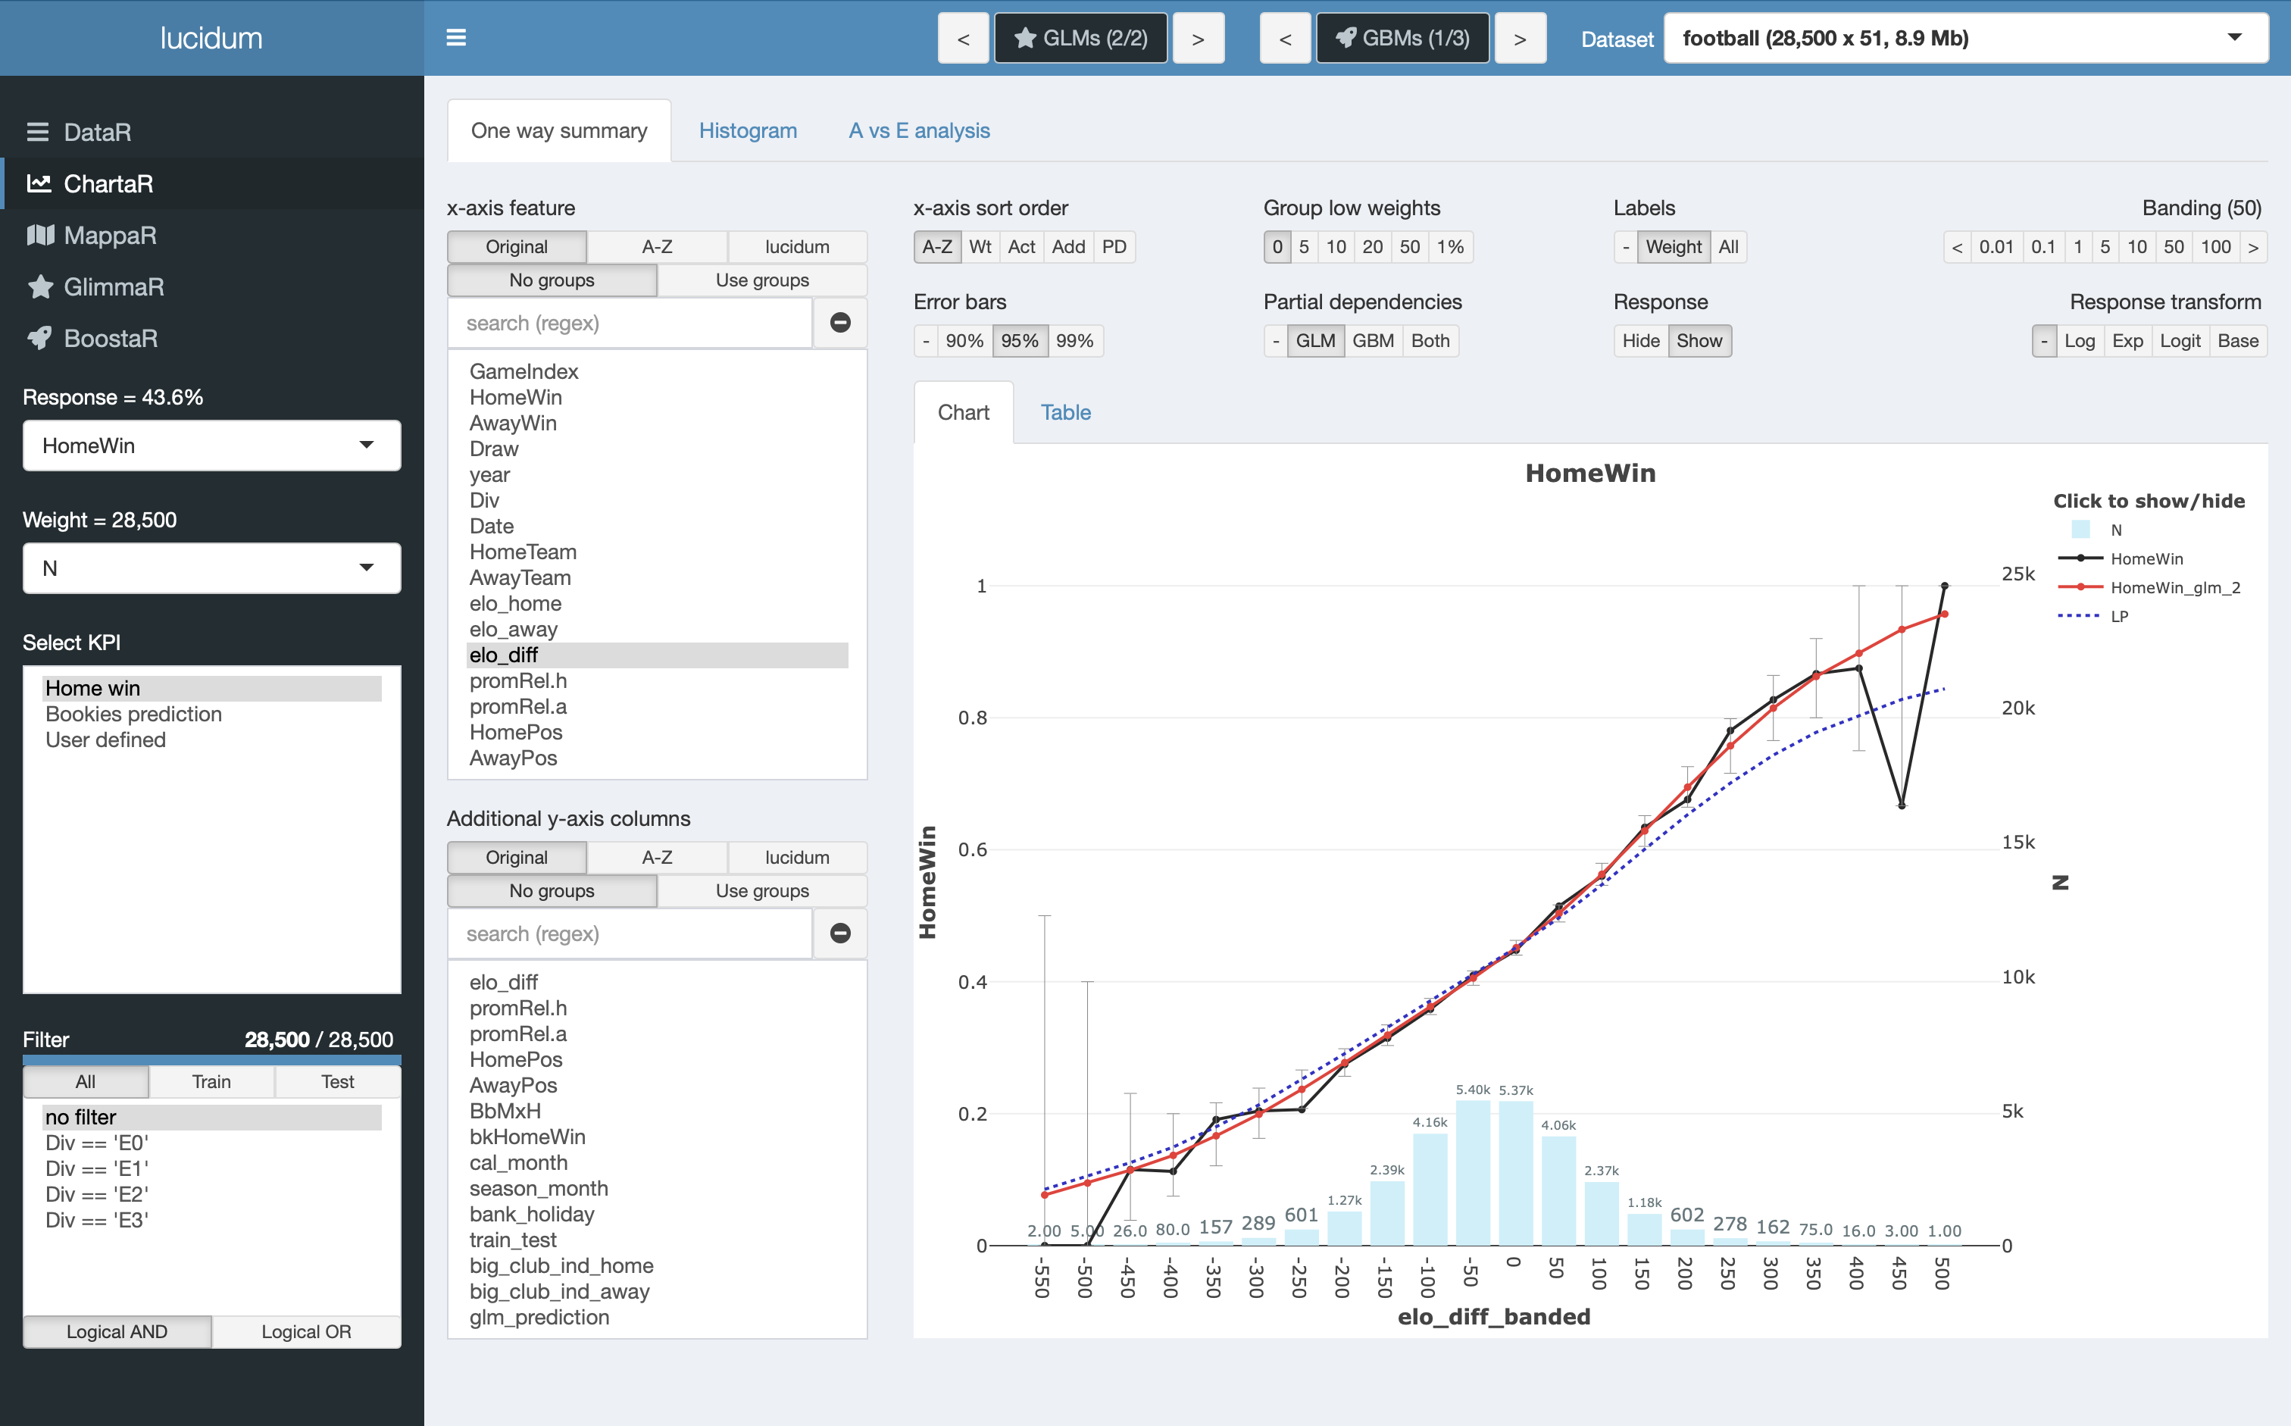
3. lucidum controls - sidebar and header
Hide/show sidebar
If you have more than one dataset loaded in your Global Environment, you can select them here
lucidum navigator
GLM and GBM model selector
Arrow buttons to cycle through models
Central button to go to GLM/GBM model summary
Select the response and weight you want to plot/map/model
Select a KPI (will update the response and weight automatically)
Applies the selected filter to charts and maps
Combine filters with logical operators

Slide 7
3. lucidum controls – DataR
Dataset viewer – view head/sample of dataset in the browser
Dataset summary – column types, min, max, mean, NA count, percentiles, frequencies
KPI specification – create, edit and save a KPI specification
Filter specification – create, edit and save a filter specification
Feature specification – create, edit and save a feature specification
shinyAce – run R commands/functions within the app

Slide 8
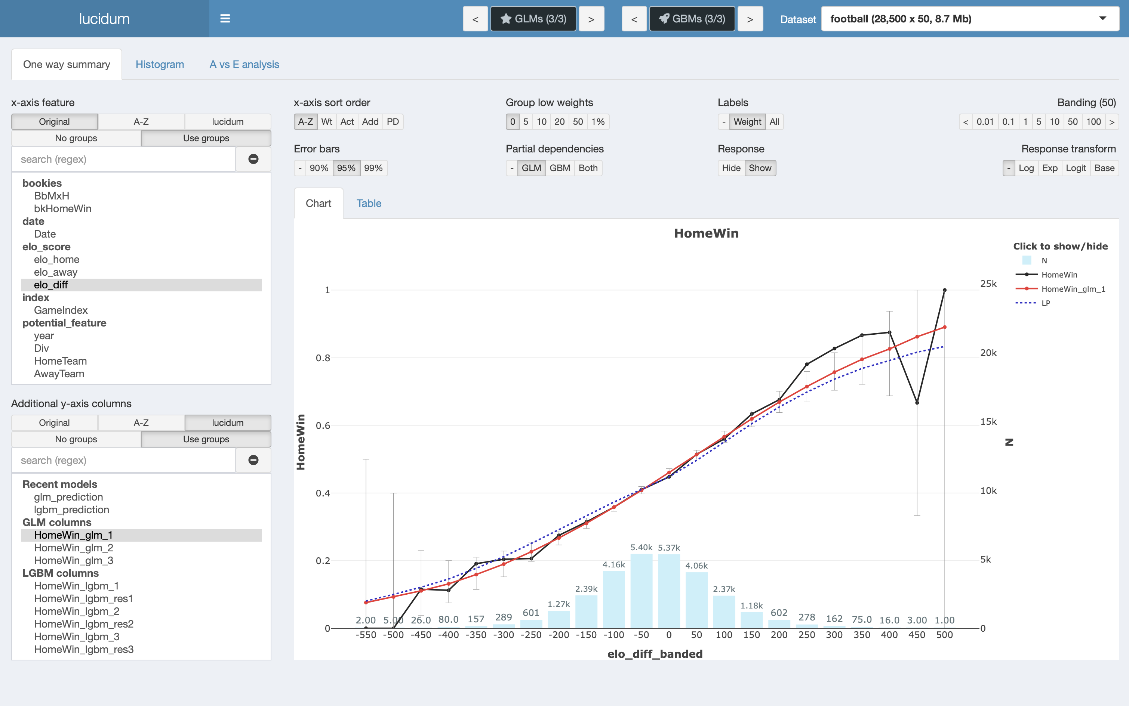
3. lucidum controls – ChartaR
x-axis sort order
A-Z: Alphabetical order
Wt: Descending weight
Act: Descending actual
Add: Descending additional
PD: Descending partial dependency
Group low weights
Groups low weight/exposure levels into a single category called “X”
Labels
Weight: Label blue weight bars
All: Label weight bars and response
Banding
For numerical features applies the selected banding
For dates bands by day, week, month, quarter or year
Error bars
For GLM’s only, applies error bars with the selected confidence interval around the GLM prediction
Partial dependencies
Shows the average linear predictor (GLM) or percentiles of the SHAP values (GBM)
Response
Hide/Show actual/predicted (to focus on partial dependencies)
Response transform
Applies the selected transformation to the y-axis
Use these options to find features more quickly
Selects feature to appear on the x-axis
View information as chart (below) or in table form
Typical chart
Black line: Actual (% of matches with a Home Win)
Red line: GLM prediction
Blue bars: Weight (number of games in each band)
Note that pre-banding of features is not needed.
Control the banding using the Banding option (top right).
The chart is based on the plotly library and provides the usual plotly controls for zoom, highlighting values, downloading a plot as a .png file.
Selects column(s) to plot on y-axis alongside the response

Slide 9
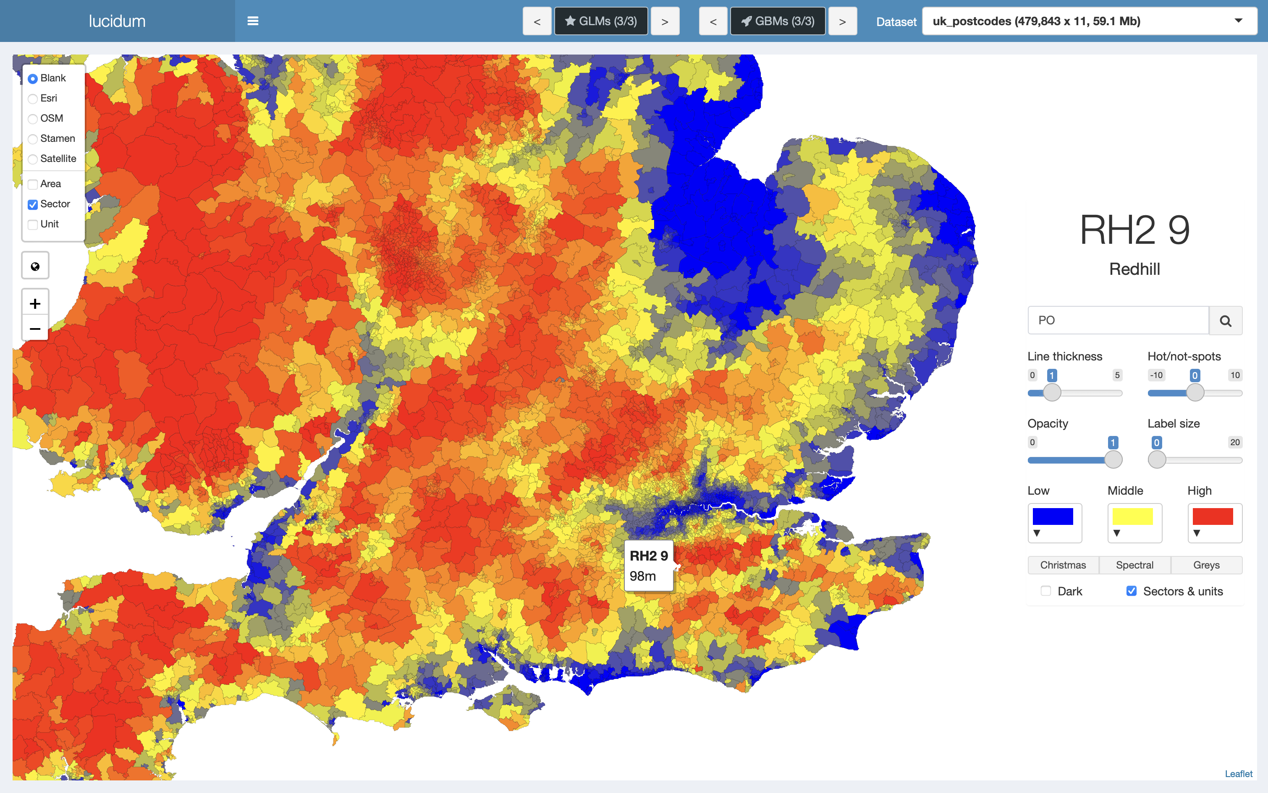
3. lucidum controls – MappaR
Example: 03_lucidum_load_uk_postcodes.R
Choose basemap tiles
Elevation above sea-level
To enable mapping, ensure that you have columns called PostcodeArea, PostcodeSector and PostcodeUnit in your dataset to be able to plot at those respective levels.
Ensure that postcodes are in the “Royal Mail” format, i.e., use the space between the incode and outcode: “PO15 7JT”, not “PO157JT”.
Converting these fields to factor will speed up operation as R summarises factors more quickly than characters.
Postcode units can only be plotted for one postcode area at a time (as otherwise the browser runs too slowly).
Postcode area performance is always fast, while sectors and unit performance depends on the browser performance.
The shapefiles built into lucidum are all open-source. The unit file is updated quarterly while the sector file is now a few years out of date. However, it is easy to use purchased shapefiles within the toolkit if preferred.
Choose map resolution
Reset map
Zoom or use mouse
Light/dark background
(e.g. to copy/paste for printed presentation)
Sectors & units are slower to map. Only select this option if you need to view the map at these resolutions.
Hover over map to see the value of the selected KPI for that postcode area, sector or unit

Slide 10
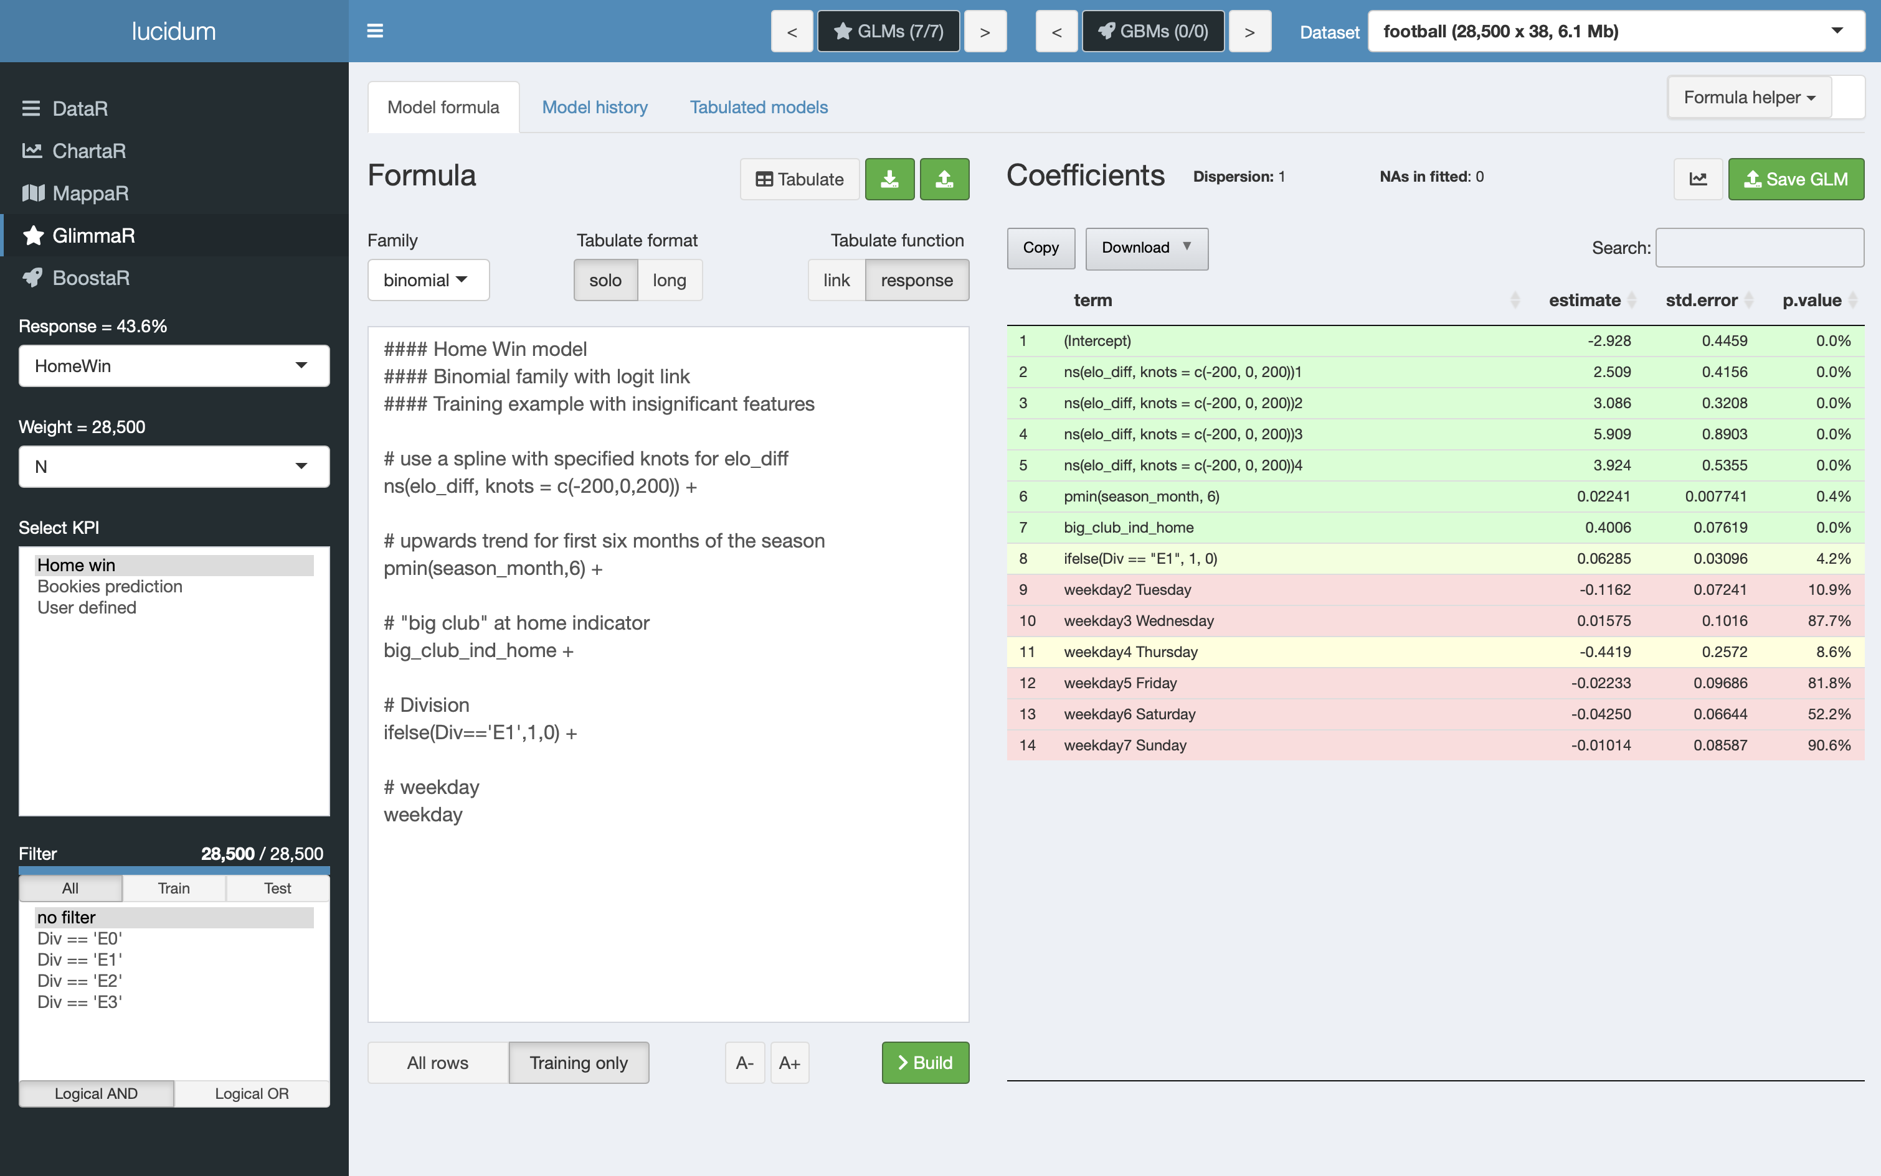
3. lucidum controls – GlimmaR
GlimmaR uses the standard R formula syntax to build GLMs
Enter the GLM formula in this text box. Comments starting with # are ignored.
Converts the GLM to tabular format. Only works for one way and 2D terms currently.
Load/Save the GLM formula.
The GLM coefficients, standard errors and colour-coded p-values.
Tools to help the user build the GLM formula and reduce typing.
Select a feature from the coefficient table and click this button to view the feature in ChartaR.
Saves the GLM as an .RDS object for use elsewhere.
Choose whether to build the GLM on all rows or just training rows.
5
2
3
6
7
1
4
8

Slide 11
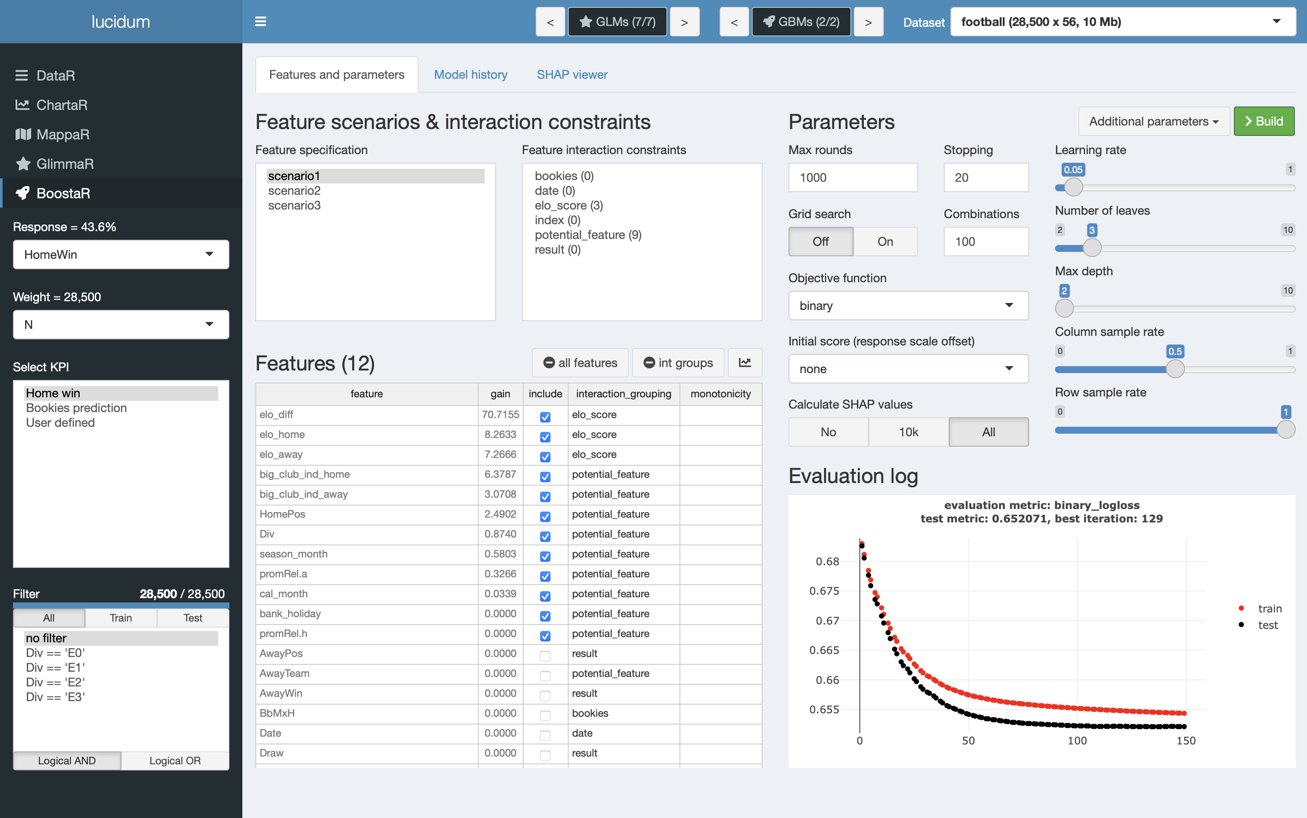
3. lucidum controls – BoostaR
BoostaR uses LightGBM to build GBMs using decision trees.
Populate the feature grid (2) with the selected scenario.
Specify which features are in the model. Table is sorted by model gain after model build.
Remove all features or just features from the selected feature interaction group (5).
Click on a feature in the feature grid (2) and then click this button to view the feature in ChartaR.
Apply feature interaction constraints to the selected interaction groupings.
Specify the maximum number of training rounds and the early stopping criterion.
Build multiple GBMs within a specified parameter range.
Choose the GBM objective function.
Begin training from a specified offset, e.g. build GBM using an existing GLM prediction as the offset to help find poorly fitted features or interaction terms.
Choose whether to calculate GBM SHAP values (can be slow on larger datasets).
Specify the most important learning control parameters.
Evaluation log for the model build.
5
6
11
1
7
8
3
4
9
2
10
12

Slide 12
4. Using SHAP values for interaction detection
Example: 04_lucidum_interaction_detection.R
SHAP values
SHAP values (SHapley Additive exPlanations) allocate model predictions down to the individual features in the model.
They are additive in the sense that the model prediction = SHAP_f1 + SHAP_f2 + … + SHAP_fn if there are n features in the model.
SHAP values are calculated before any link function is applied (i.e. analogous to the linear predictor in a GLM).
In the toolkit I apply the link function to plot the SHAP values in ChartaR on the same scale as the response.
SHAP values can be interpreted in a similar way to the GLM linear predictor to gain insight into a model – we will see this in the example.
Theoretical example
The example code simulates 50,000 rows with the first 40,000 being training rows and the last 10,000 being test rows.
The V1 to V8 (V8 not used) are all identically distributed and independent Normal distributions with mean 0 and standard deviation 1
y = V1 + V2 + V3 + 0.5×V4 + 0.5×pmax(0,V5) + 0.2×V6^2 + (one-way terms)
0.5×V1×V2 + pmax(0,V2)×pmax(0,V3) + (two-way terms)
0.4×V5×V6×V7 + (three-way term)
N(0,1) (random noise term)
In lucidum we will
Build a “no interactions” GLM and a GBM and compare the GLM linear predictor to the GBM SHAP values in ChartaR.
Build a GBM and view the importance table and SHAP values in ChartaR to gain insight into the importance and shape of the model features.
Compare the performance of the GBM and the GLM on the test rows.
Build a 1D GBM, then add on 2D terms and finally add on 3D terms to pinpoint which features are involved in interactions.
View interactions in the BoostaR SHAP viewer.

Slide 13
A1. Installation
First ensure that all the libraries lucidum uses are already installed
Clear the workspace and restart R
Source “install_libraries_for_lucidum.R”
Clear the workspace and restart R
Install lucidum
Go to Packages -> Install
Select “Install from Package Archive File”
Navigate to the location of the lucidum package (lucidum_0.0.0.9000.tar.gz) using “Browse”
Press “Install”

Slide 14
A2. Tips
Dataset
The first numerical dataset column will be set as the response when you first load lucidum.
Create a column “train_test” to distinguish training rows (value 0) from test rows (value 1). Lucidum won’t generate this column for you, you need to supply it and make sure it’s a sensible split.
Identifier columns with unique values on larger datasets (>100k) will be slow if selected in ChartaR as it first checks how many levels are in the feature before plotting. I use the feature specification to put identifier type columns into a feature grouping, so I don’t include them in a model by mistake.
How to build models on a subset of the data
Use a weight column with zeroes to remove those rows from the training data.
You must ensure that the corresponding response is also zero for those rows (e.g. you would not expect non-zero incurred claims on a row with zero claims).
User interface
You can change lucidum browser zoom level as for any other webpage.
MappaR will sometimes not refresh if you have changed the zoom level while on another tab. If this happens, zoom in and back out and the map will reappear.
Operations that can be slow running
SHAP values on deep trees built on large datasets can be very slow to generate. Turn off the option to generate SHAP values if you don’t need them, or use lower number of trees, higher learning rates and fewer number of leaves when first exploring a GBM build with SHAP values.
Summarising by character columns is slower than summarizing by factor columns, so convert character columns to factors before loading into lucidum.
Bugs
You can change the displayed dataset freely (using the top right control) before building any models, but once you have built a model avoid changing the dataset as you can’t in general apply a model built on dataset A to dataset B.
There is no error checking for invalid monotonicity parameters or additional parameters in BoostaR – if you use something incorrect LightGBM will throw an error and the app will stop.
shinyAce doesn’t start automatically when first loading lucidum. A workaround is to run the command shinyAce::aceEditor(outputId = NULL) in the console before library(lucidum).
The 10k option for SHAP values generates the SHAP values correctly for a random 10k sample of the data, but the SHAP ribbons don’t yet display correctly in ChartaR.
R GLMs store the entire modelling dataset by default as part of the model object. When you save a dataset out from GlimmaR, lucidum strips the dataset from the .RDS glm object to make the file a sensible size. However, this stripping out doesn’t occur until the model is saved and so if several GLMs are built within GlimmaR on very large datasets RAM usage will increase. I’m working on stripping out the unnecessary data from the models and still providing the GlimmaR functionality.

